Slide 1

TUTOR HUB

Slide 2
TABLE OF CONTENTS
01. Abstract
07. SDLC
02. Introduction
08. Related work
03. Problem Statement
09. Software Architecture
04. Scope and Objectives
10. Conclusion
05. Functional Requirement
11. Future work
06. Use Case / Diagram
12. Our Team

Slide 3
ABSTRACT
Access to quality education now a days is a big concern for students
as well as for their parents. With increasing competition students tend
to join after school academies or their parents hire tutor for their assistance.
Now we will build a web application on which students will have access to
certify subject expert tutors available nearby them. Students will be able to
hire a tutor according to their subject of interest. Students will also be
able to choose a tutor according to their own timetable. It will also be
beneficial for tutors as they will not have to travel a long distance to
reach their students

Slide 4
INTRODUCTION
Our platform will provide students an opportunity to select a tutor of
their own choice available nearby their location. Students and tutors
will register themselves on the system and a list of tutors available
in the area will be displayed to students from which they can hire one
or more tutors based on their area of interest and expertise of tutors.
Students will also have the facility to make a timetable with the tutor
they have hired. Tutors will be able to take online quizzes and assignments
as well. Parents will also have access to the platform and they will be
able to check their child’s performance as well as his grades in quizzes
and assignments. Parents will also have the facility to arrange a meeting
with the tutor to discuss their child’s situation

Slide 5
PROBLEM STATEMENT
Now the problem faced by majority of students and their parents is that in
today’s busy world it is very difficult to find good and trustworthy tutor
who knows his subject and also poses the art of teaching. Another problem
faced by the teachers/tutors is that sometimes they have to travel a long
distance to reach a student’s house or an academy. Now a days every second
counts and this process cause a lot of time and resource wastage as well.
Also, sometimes parent’s busy schedule cause them to miss out PTMs.
Due to this they could not keep track of their child’s performance and results.

Slide 6
SCOPE OF PROJECT
01. Access teacher through location
08. Chat-box
15. Assessment Plan
02. Verify teacher through project
09. Notifications and email
03. Rank and experience of teacher
10. Time table Management
04. Attendance Record
11. Online Course
05. Fees Record
12. Monthly Report Card
06. Feedback Report
13. Quran Classes
07. Trial based classes
14. Monthly meeting schedule

Slide 7
OBJECTIVES
The major role of tutoring app is to build a virtual tutoring environment for
student’s that produce a face-to-face experience which can assist a student to
achieve success in a given class.
Student who uses on demand tutoring app are not far away to gather the help
when it is required. This is vital in pandemic as well as when a person is
sick or ill it can cover through application.
Tutoring app helps both parents and teacher to be on one platform where they
can discuss and can-do regular meetings regarding the student.
The main objective of application is that there will be a trial base class
of two days in which a relevant teacher will visit to students’ home and if
a student satisfies the teacher will carry there will be no charges of a
trial-based class

Slide 8
FUNCTIONAL REQUIREMENTS
01. View List of teachers
08. Choose Service
02. View Profile
09. Add Feedback
03. View Schedule
10. Add Appointment
04. View Appointment
11. Add List of Teacher
05. View Feedback
12. Experience
06. Notifications and Email
13. Delete Teacher List
07. Register Student and Teacher

Slide 9
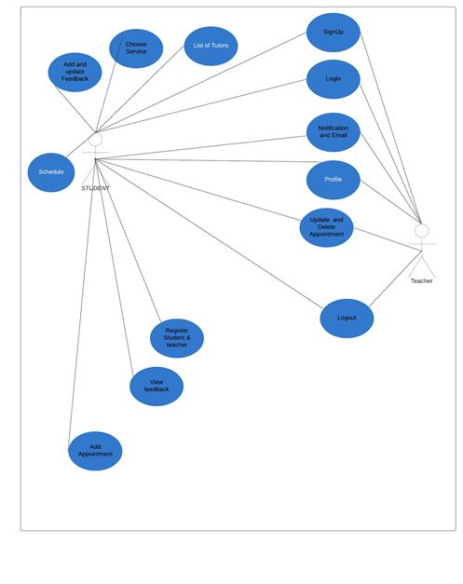
USE CASE DIAGRAM

Slide 10
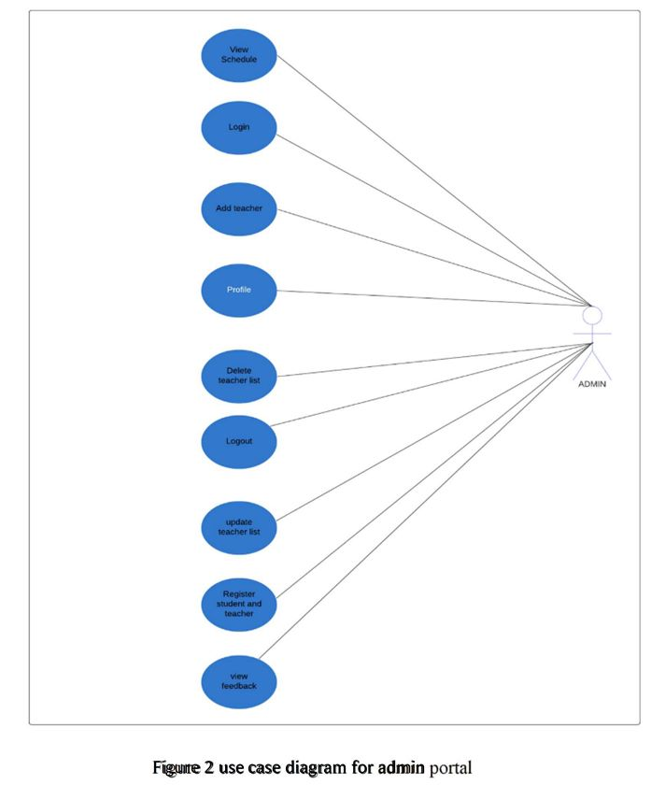
USE CASE DIAGRAM

Slide 11
Software Development Life Cycle
Agile Methodology
Key Principles of Agile Methodology
❖ Active client inclusion is basic
❖ The group must be engaged to decide
❖ Requirements develop yet the timescale is fixed
The reason of using the agile methodology in our project is that it
predicts changes and enables for much more flexibility than
traditional methods. Clients can avoid of the large changes in the
budget or schedule by making small changes. The procedure includes
separating each task into organized requirements and conveying
each independently inside an iterative cycle.

Slide 12
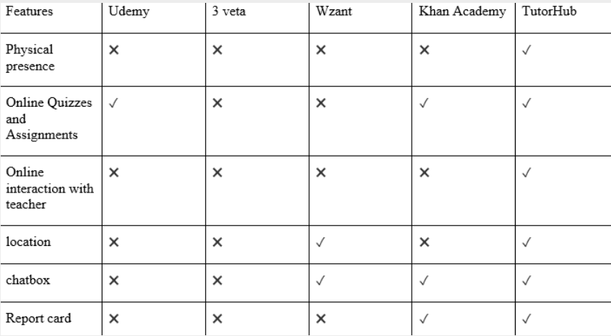
RELATED WORK

Slide 13
SOFTWARE ARCHITECTURE
The Model-View-Controller (MVC) is an architectural pattern that separates
an application into three main logical components: the model, the view, and
the controller. Each of these components are built to handle specific development
aspects of an application. MVC is one of the most frequently used industry-standard
web development framework to create scalable and extensible projects.
Model:
The Model component corresponds to all the data-related logic that the user works
with. This can represent either the data that is being transferred between the
View and Controller components or any other business logic-related data.
View:
The View component is used for all the UI logic of the application.
Controller :
Controllers act as an interface between Model and View components to process
all the business logic and incoming requests, manipulate data using the Model
component and interact with the Views to render the final output.

Slide 14
CONCLUSION
Our platform which is a web application will provide students an opportunity
to select a tutor of their own choice available nearby their location. Students
and tutors will register themselves on the system and a list of tutors available
in the area will be displayed to students from which they can hire one or more
tutors based on their area of interest and expertise of tutors.
Students will also have the facility to make a timetable with the tutor they
have hired. Tutors will be able to take online quizzes and assignments as well.
Parents will also have access to the platform and they will be able to check
their child’s performance as well as his grades in quizzes and assignments.
Parents will also have the facility to arrange a meeting with the tutor to
discuss their child’s situation

Slide 15

FUTURE WORK
0 1
May add more functionalities for the ease and benefit of stakeholders.
0 2
May expand the services of our application and launch it in different markets
0 3
May also develop an android and iOS app for the users

Slide 16
THANK YOU

